Slide 1
ECE 2504 Introduction to Computer Engineering
Hardware Description Languages: An Introduction to Verilog

Slide 2
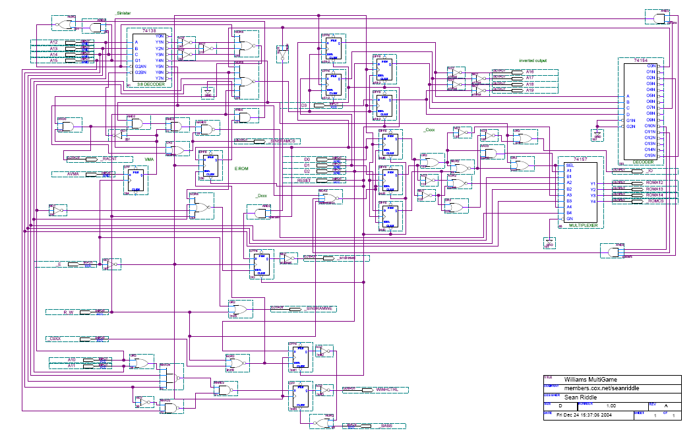
Why use a language for circuits?
Schematics quickly become tedious
No hierarchy, complex wiring, complex symbols

Slide 3
Why use a language for circuits?
Better means for exchanging information within an organization and with a customer
Model and simulate the design before prototyping
Physical prototyping is expensive and slow
Re-use previously design components
Automatically synthesize working hardware from behavioral description

Slide 4
Popular Hardware Description Languages
VHDL
VHSIC Hardware Description Language
Developed for DoD as a documentation language (1987)
Inspired by Ada language
Synthesis & simulation was added later
Verilog
Developed as a simulation language by Moorby (1985)
Driven by hardware design & ASIC industry
Synthesis was added later
Recent developments
SystemC
SystemVerilog
Analog extensions to VHDL & Verilog (mixed-signal)
Notes:
There are two hardware description languages. Verilog and VHDL.
VHDL used to be the language of choice, it is now the main one that we use.
Just because we are talking about using a language.
Always remember when using any HDL to rep hardware Is to describe hardware. Thus we need to have a well formed idea of what the digital circuit that we are terying to implement looks like and how it looks before we start writing code.
Writing code does not mean writing procedures
Verilog is not like writing I C.
HDL is not like C.
Problem solving in HDL is completely different
This will be very bad hardware.
WWHD?
It stands for What would hardware do?
The verilog we need to write needs to be based on the hardware.
Recommends that we start with paper. HDL are not design tools. They don’t tell you how to make the cirucits but rather are a way of desciibing the cirucits as a form of other means.
Verilog is simply a way of representation that is different than per say logic gates on a piece of paper.

Slide 5
Hardware Description Languages
HDLs look like software, but they are used to model hardware
Similarities: structured code, sub-modules, functions
Differences: Timing is explicit in HDL, concurrent rather than serial execution
HDLs support concurrency – More than one thing going on in the hardware at a time, many signals changing simultaneously
HDLs support modeling at more than one level of abstraction
Gates
Boolean equations
Register transfer
Algorithm (we won’t use this in our course)
Three main types of models:
Structural: interconnections of components (gates, modules)
Dataflow: binary/arithmetic operations on signals
Behavioral: functional and algorithmic representation of circuit (we won’t use this either)
Notes:
Issues relating to HDL is that it looks and taste like software.
Similarities to C and HDL like other high launaguges
But in its most basic form, it centers on trying to ‘write’ hardware.
It runs it all simulataneously, not serially. This is because eleements in a circuit need to run concurrently whereall signals will be running You will get errors otherwise.
The elements in the HDL code will exist concurrently in some system and should be treated as such. Where it is not procedureally or a line by line basis.
A number of differen levels where we can talk about modelling digital systems.
We have gates, boolean equations, register transfer and alogrhtyms.
HDL like in verilog have three different models to discribe HDLs.
Structure is at the very base.
We will get as far as to get to dataflow.
When we get to dataflow, we may have a + representing addition and not ‘an AND’ gate.
In Verilog, we can write that we can add two values and not the logic that relies on what underlies how addition works.
Behaviorlal describes what is going on in hardware as a sequence of steps as a way to get the desired result

Slide 6
Basic Ideas in Verilog
Hardware is captured in modules
Modules can be hierarchical
Modules have a type and are instantiated
C types are instantiated into variables
main module
module
instance
module
module
Main
NAND gate
Multiplexer
Multiplexer
type

Slide 7
Example
mylogic (typename)
INV1 (instance name)
module mylogic(a, b, c, q)
input a, b, c;
output q;
wire n1, n2;
inv INV1(n1, a);
or OR1(n2, b, c);
and AND1(q, n1, n2);
endmodule
AND1
a
n1
q
n2
b
c
OR1
Notes:
Module is like a function. Not a struct
We have to represent a module to describe the hardware that is contained in the circuit that we are truying t o represent
Begins with a module declaration. Some name that is given to it called mylogic in this case and a port list that describes the inputs and outputs that the module may have. You define all the inputs and outputs together
Where beneath it you declare inputs are identified as such and outputs are identified as such here as well. Where you are then definning what a wire as now as well. Where the input does not need to be defined as a wire.
These wires are internal connections of a module. We use the designation wire to describe these connecting signals.

Slide 8
Example
port list
mylogic (typename)
INV1 (instance name)
module mylogic(a, b, c, q)
input a, b, c;
output q;
wire n1, n2;
inv INV1(n1, a);
or OR1(n2, b, c);
and AND1(q, n1, n2);
endmodule
AND1
a
n1
q
n2
b
c
OR1
PORTS

Slide 9
Example
mylogic (typename)
INV1 (instance name)
module mylogic(a, b, c, q)
input a, b, c;
output q;
wire n1, n2;
inv INV1(n1, a);
or OR1(n2, b, c);
and AND1(q, n1, n2);
endmodule
AND1
a
n1
q
n2
b
c
OR1
PORT DIRECTION: INPUT OR OUTPUT

Slide 10
Example
mylogic (typename)
INV1 (instance name)
module mylogic(a, b, c, q)
input a, b, c;
output q;
wire n1, n2;
inv INV1(n1, a);
or OR1(n2, b, c);
and AND1(q, n1, n2);
endmodule
AND1
a
n1
q
n2
b
c
OR1
INTERNAL WIRES

Slide 11
Example
PORT 2 connects to a
PORT 1 connects to n1
mylogic (typename)
INV1 (instance name)
module mylogic(a, b, c, q)
input a, b, c;
output q;
wire n1, n2;
inv INV1(n1, a);
or OR1(n2, b, c);
and AND1(q, n1, n2);
endmodule
AND1
a
n1
q
n2
b
c
OR1
SUBMODULE INSTANTIATION
Wires are connected by 'positional assignment'
Notes:
Verilog does have its own built in inverter typed as inv
But for this one, imagine we created a module that acts as an inverter.
Because inv1 is inside of this moduel. That one of its ports is coming fromm the wire n1 even though it is an output. How do you know what is the output and the input? You would have defined it that way in another module you would have written.
Go to the net slide

Slide 12
Example
module inv(q, i)
input i;
output q;
endmodule
module mylogic(a, b, c, q)
input a, b, c;
output q;
wire n1, n2;
inv INV1(.i(a), .q(n1));
or OR1(n2, b, c);
and AND1(q, n1, n2);
endmodule
mylogic (typename)
INV1 (instance name)
AND1
a
n1
q
n2
b
c
OR1
What if you don't remember what port the input of 'inv' is on: port 1 or port 2? Use 'named assignment'
inv INV1(.i(a), .q(n1));
Notes:
Note that the order of the ports of abstantiation match the

Slide 13
Modeling groups of wires & words
Draw the schematic of this circuit
module FOUR_INPUT_AND(o, a);
output o;
input [3:0] a;
wire w1, w2;
and gate1(w1, a[0], a[1]);
and gate2(w2, a[2], a[3]);
and gate3(o, w1, w2);
endmodule

Slide 14
Modeling groups of wires & words
Draw the schematic of this circuit
module FOUR_INPUT_AND(o, a);
output o;
input [3:0] a;
wire w1, w2;
and gate1(w1, a[0], a[1]);
and gate2(w2, a[2], a[3]);
and gate3(o, w1, w2);
endmodule
a
gate1
a[0]
w1
a[1]
gate3
o
gate2
a[2]
w2
a[3]
Notes:
How do we know which ones are inputs and outputs? There is a section that indicates what the iput and output are.
We can thus associate it as an input and output.
Where o is a scalar which is an individual unit. Single one bit value representative of the output in quesiton
A is a vector. It is a collection off one bit signals. The one bit signals that are int his vector have a particular order of signifigance. There is a distinction. You should think of an vector as an array of bits.
Imagine that all a is that an array of individual signals.
Verilog has the benefit that unlike C, it has a bit indexible languange. If you are in c and have int x. Then you are not in a position where you can reference x[15]. Because int, native data types, are not arrays. So you can’t do it. But you can’t work with it like that.
But you could do int x[5] and do x[1]. But since x is stil an int
Verilog is different so ignore all that kind of stuff.
We will have a set of wires that connect some output to some intput. They are internal to the circuit.
Output always comes first. Output followed by the input.
You define a 2 or 3 input AND gates based on how many things you give it. If you gave gate1 another a such that it becomes andgate1(w1, a[0], a[1], a[2]), then it will be a three input AND gates.

Slide 15
Modeling time
In Verilog, time is explicitly modeled
Why? Because we describe a parallel system !
C code is
sequential
HDL code is
concurrent
function1 {
}
main {
function1();
}
module and {
}
main {
and and1
and and2
and and3
}
execution order
is implicit
execution depends
on time of inputs changing
Notes:
Verilog schematics exist because HDL represent concurrent code.
This means everyting runs at the same time.
It all exists simultaneously

Slide 16
Signal Values are mapped on a time axis
inv1
inv2
a
n1
q
t1
time
a
Notes:
A circuit consisting of two inverters. A real circuit element will have a 0 delay associated with it

Slide 17
Signal Values are mapped on a time axis
inv1
inv2
a
n1
q
t1
t2
time
a
n1
module inv1
sees 0->1 on
input
d
module inv1
sends 1->0 to
output AFTER d
Notes:
. When the value of a changes. . Then we see there is a change.
WE might take the first game to have a delay of d time units. Meaning after d time units, then n1s values will change in response to what it had up bove.

Slide 18
Signal Values are mapped on a time axis
inv1
inv2
a
n1
q
t1
t2
t3
time
a
d
n1
q
module inv2
sends 1->0 to
output AFTER d
module inv1
sees 0->1 on
input
d
module inv2
sees 1->0 on
input
module inv1
sends 1->0 to
output AFTER d

Slide 19
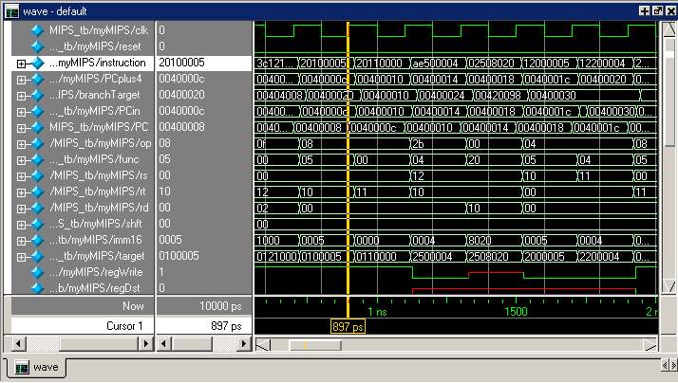
Output of a typical Verilog simulation
Signals (some are grouped in buses)
Time

Slide 20
Output of a typical Verilog simulation
Signals (some are grouped in buses)
At cursor time (897ps), signal func carries value 0x05
Time
Notes:
At a particular time, a specific input has a certain value. That at a particular time in response. That some other output will make a response.

Slide 21
Verilog Notation
Verilog is:
Case sensitive
Based on the programming language C
Comments
Single Line
// [end of line]
Multiple Line
/*
*/
List element separator: ,
Statement terminator: ;

Slide 22
Verilog Notation
Binary Values for Constants and Variables
0 or 1
X,x - Unknown
Z,z – High impedance state (open circuit)
Constants
n’b[integer]: 1’b1 = 1, 8’b1 = 000000001, 4’b0101= 0101, 8’bxxxxxxxx, 8’bxxxx = 0000xxxx
n’h[integer]: 8’hA9 = 10101001, 16’hf1 = 0000000011110001
Identifier Examples
Scalar: accum, ALUout, reset_n
Vector: sel[0:2], func[0:5], mac[31:0], sum[15:0]
Notes:
Neeed to allocate enough bits or else I
It wont give you an error which is problematic as you’ll have to hunt for the issue.

Slide 23
Verilog Keywords & Constructs
Keywords are lower case
module – fundamental building block for Verilog designs
Modules are used to construct design hierarchy. They cannot be nested, but you can instantiate instances of one module inside of another.
endmodule – ends a module.
This is not a statement, so it is not semicolon-terminated.
Module Declaration
module module_name (module_port, module_port, …);
Example: module full_adder (A, B, c_in,c_out, S);

Slide 24
Verilog Keywords & Constructs
Primitive Gates
buf, not, and, or, nand, nor, xor, xnor
Syntax: gate_operator instance_id (output,input_1,input_2,…)
Examples:
// f = a & b
and A1(f, a, b);
// w = a + b + c, x = b + c + d + e
or O1(w, a, b, c), O2(x, b, c, d, e);

Slide 25
Verilog: Structural models
Circuits can be described by a netlist as a text alternative to a diagram.
module fig519s (a0, b0, c0, c1, s0);
input a0, b0, c0;
output c1, s0;
//Seven internal wires needed (poor form)
wire[7:1] net;
//Ports on primitive gates listed output port first
not G1(net[3],C0), G2(net[5],net[2]), G3(net[6],net[3]);
nand G4(net[1],A0,B0);
nor G5(net[2],A0,B0), G6(C1,net[2],net[4]);
and G7(net[4],net[1],net[3]), G8(net[7],net[1],net[5]);
xor G9 (S0,net[6],net[7]);
endmodule

Slide 26
Verilog Example: Dataflow (Boolean operators)
The assign statement is evaluated whenever a value on the right hand side changes. Unlike C, the order in code does not affect order of execution.
module full_adder_1b(a, b, c_in, sum, c_out);
input a, b, c_in; output sum, c_out;
assign sum = a^b^c_in; assign c_out = (a&b) |(c_in & (a^b));
endmodule
Notes:
What exists on the right hand side of the assingment is an expression. When ever any net or vairable that is on the right hand side of the assignment changes its value. The left hand side will re evaluate to change the expression.
It is lke having a circuit, where if you change any of the inputs, then the outputs will change as a result.
The example is a 1 bit full ader
The carat operator is a reprsentation of the binary Xclusive Or function. The & is an AND operator. The vertical bar represents the OR operator.

Slide 27
Dataflow Operators – Bitwise
NOT ~
AND &
OR |
XOR ^
XNOR ~^ or ^~
Example:
input[3:0] a,b;
output[3:0] z;
assign z = a | ~b;
Notes:
Can carry bitwise operator available to us in a structural world.

Slide 28
Dataflow Operators - Shift
Shift-right >>
Shift-left <<
The result has the same precision as the operand. These are called logical shifts. (We will learn more about shift operations later.)
a = 4’b1010;
...
assign d = a >> 2; // d = 0010
assign c = a << 1; // c = 0100
Notes:
Haven’t gotten to shift yet\
You shift it how many ever places. IT’s a frame of reference in where osme bits can dissapear.
If given negative 1111. 2s comp for 01
If given 0100, +4, right shifted 1 then becomes 0010 it is then +2 so 4/2 is 2
If 1100 and we shift one right. Then we get 0110, so not right.
As long as overflow doesn’t happen. IT can perform multiplicaiotn by a power of two.

Slide 29
Dataflow Operators – Concatenation, Replication
Concatenation:
{op1,op2,…}: Concatenates op1, op2, ... to a single number.
The operands must be sized!
a = 1’b1;
b = 3’b010;
c = 3’b101;
assign catx = {a, b, c}; // catx = 1010101
assign caty = {b, 2’b11, a}; // caty = 010111
Replication:
assign catr = {4{a}, b, 2{c}}; // catr = 1111010101101
Notes:
Concactention: linking things together
For caty, it is b which is 010, folloewd by 11, followed by a which is 1 so caty = 010111
This is essentially concateation where you represent many ‘operations’ into a single number so it is combined.

Slide 30
Dataflow Operators – Arithmeic, Logical, Relational
Addition +
Subtraction -
Logical complement !
Logical AND &&
Logical OR | |
Greater than >
Greater than or equal to >=
Less than <
Less than or equal to <=
Notes:
// x is a 4 bit value signed 2s comp representation
// where I want to come up with a value of y where y should equal x dividied by 4
Assign temp = x >> 2
// where temp is assigned to x moved to the right two places.
If x = 0100
Then moving it over two places makes temp 0001 where 4/4 is thus 1 which is right.
We put the sign bit into the zero fill location so if it is positive then we put 0s for zero fill but if the number is neg, then we zero fill with 1s
Then we assign to y the value of the concatenition
Assign y = {x[3], x[3], temp[1:6}}
Where since x is 11000100
Y is 1111000
So you first assign it the third vlaue of x and x to get the 1 1 in y and then you give it the values of temp
\hiing right is the same thign as vidiing by a power of two.

Slide 31
Dataflow Operators – Equality Operators
Logical equality ==
Logical inequality !=
Case equality ===
Case inequality !==
assign a = (4’b 1111 == 4’b 1111) \\ a = 1
assign b = (4’b 1010 != 4’b 1010) \\ b = 0
assign c = (4’b 1z0x == 4’b 1z0x) \\ c = x
assign d = (4’b 1z0x != 4’b 1z0x) \\ d = x
assign e = (4’b 1z0x === 4’b 1z0x) \\ e = 1
assign f = (4’b 1z0x !== 4’b 1z0x) \\ f = 0
Returns 0, 1 or x
Returns 0 or 1

Slide 32
Conditional Operator
assign Y = ( A == B )? C : D; // Y = C if A == B, else Y = D
Example:
wire [1:0] select;
wire [15:0] D1, D2, D3, D4;
wire [15:0] bus;
assign bus = (select == 2’b00) ? D1 : (select == 2’b01) ? D2 : (select == 2’b10) ? D3 : (select == 2’b11) ? D4 : 16’bx;
? : | 0 | 1 | X | Z
0 | 0 | X | X | X
1 | X | 1 | X | X
X | X | X | X | X
Z | X | X | X | X
“z” is not allowed in conditional_expr.
If conditional_expr is ambiguous, both true_expr and false_expr are evaluated bitwise according to the truth table to get the result.
Notes:
If conditional expression is true, y = c, else y = d
If looking at if x>2 then y = a and x <5. Else y = b
Then we do it in verilog dataflow by making that the conditional expression
Assign y = ((x>4’b0010)&& x<4’b0101)) ? A:B
If it is true, then it assigns y to a, if it is false, then it assigns it to b
You put all of ths on the select line in where verilog will do it for you

Slide 33
Verilog Example: Dataflow (Arithmetic operators)
module full_adder_1b(a, b, c_in, sum,c_out);
input a, b, c_in;
output sum, c_out;
wire[1:0] add_out;
assign add_out = a + b + c_in;
assign sum = add_out[0];
assign c_out = add_out[1];
endmodule

Slide 34
Verilog – Summary
Much more to the language than this brief introduction
We’ll use it for simulation and synthesis.
Structural and data flow models
We won’t cover behavioral models (case, if-then-else, for…)
Take Digital Design I to learn more.

